Slide 1
Employment Certification Program
Resume Writing
Workshop 3
Copyright © 2014 by Memorial Assistance Ministries. All rights reserved.

Slide 2
Job Search Red Flags
http://mamjobsnetwork.org/articles/job-search-red-flags-cnn-video/

Slide 3
The Basics of
Job Recruitment
“Think like an Interviewer not an Interviewee”
There are 2 questions a Hiring Manager asks him/ herself that are the essence of the recruitment process:
  Q1: Is this person qualified to do the job?
  Q2: Will this person fit into my organization?
If the answers to both questions are YES you are on the short list with a good chance of being hired.

Slide 4
The Basics of Job
Job Recruitment
The process has two parts:
Resume Review
Job Interview
The Resume answers Q1 and gets you the Interview.
The Interview answers Q2 and can get you the Job.

Slide 5



Online Job
Search Process
1. You and a thousand other people submit your resume online.
2. An optical scanner reads them and selects the 50 best according to key word matches.
My resume
3. Someone in HR reads the top 50 and whittles the stack down to about 8 to 10 for the hiring manager to review.
4. The hiring manager interviews about 3 to 5 and, if he/she likes a candidate, makes a selection. Hopefully, it’s you.

Slide 6
Customize Your Resume to
Each Job Application
It is no longer considered a successful tactic to have a “one-size-fits-all” resume
Create a “base” resume that contains all the facts and details
For each application, submit a customized resume, tweaked to make it relevant to the job you are applying for
Use “key words” from the job description in your resume – use all of them you can, but always be honest about your skills, experience and education – no fudging! Use “skill” verbs – no pronouns!
Optical scanning software used by many employers will score your resume higher if you use the key words, giving you a better chance of getting noticed in the big pile

Slide 8
Resume Writing
  The Best Resume:
  Targets a specific job
  Supports your qualifications for the targeted job
  Is concise, clear and to the point (and NO typos!)
  Clearly highlights your skills and qualifications
  Is an honest presentation of your best attributes

Slide 9
Resume Writing
When drafting your resume remember these important tips:
Don’t lie or exaggerate – automatic rejection!
Don’t use anything but white paper – colored paper doesn’t scan or photocopy well
Don’t use thick paper – it jams copy machines (Use good quality plain white paper instead.)
Don’t use creative fonts! Instead, use a commonly used font and font size, such as Times New Roman and no smaller than 10 to 12 point font size)
Don’t use ALL CAPS – the human eye processes “all caps” 50% slower than a mix of upper and lower case letters
DO triple check your spelling and grammar, it counts!
Avoid repetition
Make it fit on one page
Did you know that the average recruiter looks at a resume for just 30 seconds or less?

Slide 10
Resume Content
Make it easy to contact you:
  Your name at the top
  Phone and email address prominently displayed below your name
Use a simple, visually appealing template with lots of white space
You may only get ONE call, make sure the telephone you list has an answering machine or voicemail service. The message should always be professional, like this:
“Hello, this is Mike Smith, please leave your name and phone number and I’ll get back with you as soon as I can.”
NO music, slang or catchy phrases…
ALWAYS return calls promptly and without music or distracting noise in the background…try not to use speaker phone, it’s difficult to hear and seems unprofessional
Use a professional email address such as mike.smith@gmail.com

Slide 11
Resume Content
What goes where?
In what order should I put my skills, education and work history?:
Some of us suggest starting with a Professional Summary of what you have to offer a potential employer. (It’s a version of your elevator speech.);
Next, include a bulleted list of Skills & Abilities – skills on the left and abilities on the right;
Follow this with your Employment History; and then
Education.
Recommended: Meet with a Volunteer Job Coach to determine which style works best for you. It is sometimes recommended that if you have little job experience to list your education first or vice versa if you have lots of experience.

Slide 12
If You Include a Qualifications Summary…
First part is narrative. Two to three sentences maximum. First sentence is your strongest statement of who you are and what you can do for the employer. Second (and third) sentences provide additional important information pertinent to “why should I hire you?”
Second part is a bulleted list of skills that you bring to the position. No explanations, just a list of your skills: technical, managerial, sales, etc.

Slide 13
Writing Your
Summary Statement
If you use a Summary Statement it is the first sentence of your resume and it is helpful for getting the rest of your resume read. In it you need to powerfully and succinctly tell the reader, 1) who you are and 2) what you can do for him/her.
It is important to understand that recruiters do not care about your job search objectives NEARLY as much as they care about what you can do for them. Write this sentence from the perspective of what you can do to help the employer meet his/her objectives. Instead of placing this on your resume you can also use it in your cover letter.
Here is an exercise that will help you create just such a powerful sentence:
List 3 to 5 of your best traits:
(adjectives that describe you)
___________________
___________________
___________________
___________________
___________________
List 3 to 5 of your best learned skills:
___________________
___________________
___________________
___________________
___________________

Slide 14
Resume
Summary Statement
Now, let’s fashion these thoughts into a powerful sentence that will get the rest of your resume read:
_______________, ____________________ _______________________,
(adjective) (adjective) (noun phrase)
with XYZ [number] of years experience in [type of industry of work]__________________________________.

Slide 15
Sample Resume
Summary Statements
Remember these key points: Factual, Short, Distinctive
Disciplined, organized administrative professional with more than six years experience in
Enthusiastic, personable retail sales professional seeking the opportunity to increase store sales on a per-client basis.
Tough, diligent financial and accounting professional seeking the opportunity to find the dollars currently lost by improving efficiency and effectiveness of operations and administration.
Detail-oriented medical billing and coding specialist with fifteen years experience in private and large medical practices.
[Note the simplicity and lack of “buzzwords”]

Slide 16
Skills and Talents
SAMPLES for your Check List:
Technical skills
Software proficiency
Machinery operation
Business skills (including International business experience)
Selling skills
Profit / loss responsibility
Language skills
Indicate languages and level of proficiency (fluent, proficient, functional) and whether you can speak, understand, read and write in those languages
Managerial skills
Employee recruitment
Leadership development
Budgeting
Business planning
Work-flow planning
Supervisory skills
Recruitment, hiring
Training & coaching
Teambuilding
Performance management
Certifications & Licenses
CNA and other medical
ISO-9001
IT
Oil & Gas
Commercial driver’s license
Tailor the list to your audience/the job you seek. Remember to give them what you think they are looking for, and nothing else.

Slide 17
Employment History
For older workers go back 10 – 15 years. Younger workers list jobs even if they are not relevant to the position advertised.
Employment :
Most recent job first
Name of employer, City and State
Dates employed, from MM/YYYY to MM/YYYY
Briefly describe on-the-job accomplishments, achievements and results
You WILL be asked why you left your job (or want to leave your current job) – be prepared to answer.
  Note: it is OK to have been laid off during a sluggish economy.
If you worked for several companies via a Temp Agency – list the Agency and the total time with them. Sub-head the actual companies and what you did for them (payroll processing, mail clerk, legal assistant, etc.)
Notes:
Regarding reason for leaving your last job, the reason should not draw undue attention. Do not bad-mouth your former employer. It is enough to say “downsizing”, “change in business strategy”, or, in the event of a health or family emergency to state that (with as little detail as possible). You want the employer to be confident that the situation has been resolved and that you learned from the experience.

Slide 18
Education
If you lack job experience but have lots of education - list education first.
If you have lots of job experience but lack education - list experience first.
Only list graduation date if recent (within the last five years)
If you have a college degree - no need to list your high school
For all education be sure to include:
  Name of Institution
  Location – City and State
  Degree earned – field of study
  GPA if higher than 3.5 and only if degree was earned in the last five years

Slide 19
Education
Have Post-High School classes but no degree? – List High School then list college as “Attended”
GED can be listed as a HS Diploma, unless they ask for name of school
No HS Diploma or GED – do not include an Education section
Include employer-sponsored training if it is relevant to the new job
Currently taking classes relevant to the job? – list topic, skills or knowledge acquired, accomplishments, projected Graduation or Certification date.

Slide 20
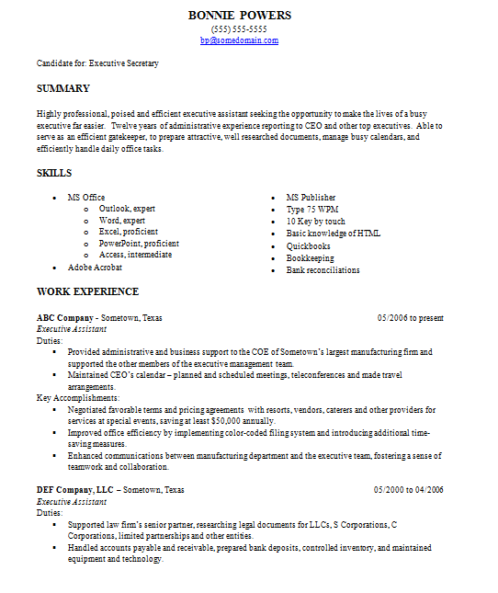

Slide 21
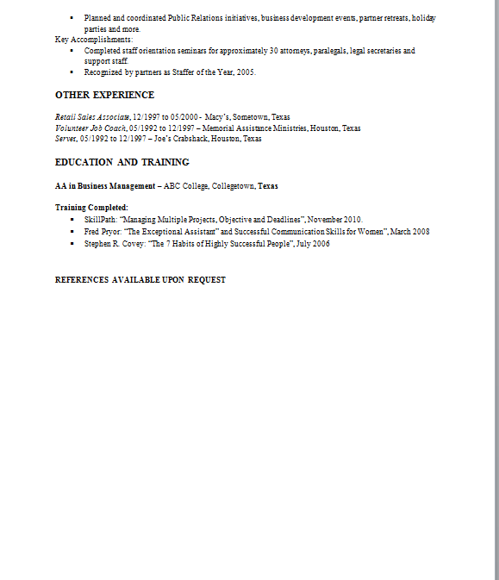

Slide 22
References
List on a separate sheet OR write “References Available on Request” at bottom of resume
Check with your references before you list them – “May I list you as a reference?”
Give each reference a heads-up when an employer indicates they plan to check references – be sure to tell them about the job and who will call and from which company.
  Check that you have current contact information for all references!
Ex-Military
List type of discharge
  Use Civilian language, e.g., change “NCOIC” to “Supervisor”

Slide 23
Record Keeping
Keeping up with dates of employment, salary, titles, name and contact information of supervisors, etc. is critical! It might be helpful to create a spreadsheet including:
Hire date/ end date for each job – record Day, Month and Year for start and end of job
Name and contact information for each employer
Supervisor names and titles
YOUR job titles
Salary for each position
Do the same for references! Be sure to include:
Name of reference and how they know you (colleague, boss, client, customer, etc.)
Mailing address
Email address
Phone number
Do not include “personal” references (friends or relatives), they are irrelevant. If you have no paid job experience, be sure to include volunteer activities…these are great for references!

Slide 24
Job Applications
There will be a job application to fill out – fill out everything applicable to you. Write in NA (not applicable) where not. Do not leave anything blank.
Be sure everything matches your resume – the employer will check. (Have a copy of your resume handy AND a copy of your spreadsheets.)
Do not write “see resume” even if you are repeating the information on the resume. The application could get separated from the resume. “See resume” might give the appearance that you take short cuts and this could be viewed negatively.

Slide 25
Cover Letters
Always include a cover letter when mailing your resume
The same text can be used in an email to which you attach your resume, simply copy and paste. DO NOT merely send an email that says “see attached” with no introduction or expression of interest in the job.
Must haves:
  Your contact information
  Date
  Person you are writing to – name and title (double check spelling of names)
  Why you are writing. “Thank you for the opportunity to apply for ABC position…”
  Name the position for which you are applying

Slide 26
Cover Letter Content
If possible, include the name of the person who will receive your resume. If you can’t get a name, it is ok to use “Dear Hiring Manager”, “Review Committee”, “Recruitment Team”, etc.
Refer to the specific job for which you are applying and where you saw the posting, “Thank you for the opportunity to apply for the Administrative Assistant position I saw posted in the Houston Chronicle on Sunday.”
Include a brief statement about your interest in the job and why. “As you will see on the attached resume I have extensive experience in outside sales and have an excellent track record of generating new customers. I would love to join the team at ABC company to help grow your customer base.”
Include a statement about what inspires or motivates you. “What motivates me most in my work is the sense of accomplishment that comes with tackling an important project and seeing it through to completion.”

Slide 27
Cover Letter Format
Your Name
Your Phone Number
Your Email Address
(hit return two or three times)
Date (in word format: July 10, 2014) – hit return three times
Name of Company Contact
Company Name
Company Street Address
City, State, ZIP – hit return two times
re: (position title for which you are applying) – hit return two times
Dear (name of person you are sending it to OR “Hiring Manager”, etc.): - hit return two times
Body of Cover Letter

Slide 28
Cover Letter Sample
Melissa Johnson
555-245-6577
m.johnson@gmail.com
(return three two or three times)
July 10, 2014 – return three times
Mr. Jameson Wilkes
ABC Healthcare
2455 Main Street
Houston, Texas 77006 – return two times
re: Administrative Assistant Position – return two times
Dear Mr. Wilkes: - return two times
Body of Cover Letter

Slide 29
Following Up
Once you have submitted a resume (or an application), it is still YOUR RESPONSIBILITY to follow up if you want an interview.
  Some managers wait to see which applicants will follow up as a tool for whittling down the pile
To follow up, you must have a name and contact information.
  Try to get the name, phone number and email address of the person responsible for processing the application. You will have better success if you follow up with a person by name
Use “polite persistence” and follow up once per week, or on whatever schedule they tell you.
Use a system to keep track of your applications, so you know when to follow up.
This is not tennis. The “ball” is never “in their court”. It’s always in YOUR court.

Slide 30
Keep a Log

Slide 31
Final Tips
Gaps in employment can be a big red flag. Be prepared to explain them. A Volunteer Job Coach can help with this, be sure to make an appointment!
Employers will Google you. Check out your online presence. Take corrective action as necessary. Everything an employer sees or reads about you should inspire confidence in your character, your abilities and your work ethic.
The following website takes snapshots of virtually everything on the web. If you remove something, employers can still view the archive! www.waybackmachine.org
Sign up for resume help and update resume before Interview workshop next week!

Slide 32

5 Tips to Boost
Your Resume
http://mamjobsnetwork.org/articles/5-tips-to-boost-your-resume-nbc-today-show-video/

Slide 33
Homework!
Re-work your resume tonight using the information presented today
Schedule a one-on-one meeting with a Volunteer Job Coach, or a member of our staff, to review your resume no later than next Monday, take good notes and then further revise your resume.
Bring your revised resume to Workshop 5, Interviewing. If you fail to bring your resume to Workshop 5, you cannot participate in Workshop 5.
Be sure to send your final resume to bzewede@maministries.org and also to post it on MAM’s Job-Finding Network. You can register and post at www.MAMjobsnetwork.org

