Slide 1
Employment Certification Program
Knowing Yourself
Workshop 2

Slide 2
Who are you?
If you were to meet yourself…
What would be your first impression?
What would you want to know?
What would you want people to remember about you?
What would they remember about you?

Slide 3
The Elevator Speech
What IS an elevator speech?
At a basic level, it’s your introduction when you meet new people
First (last?) opportunity to make a strong and positive impression
An opportunity to gain an ally in your job search
An opportunity to grow your personal network
An opportunity to get your foot in the door

Slide 4
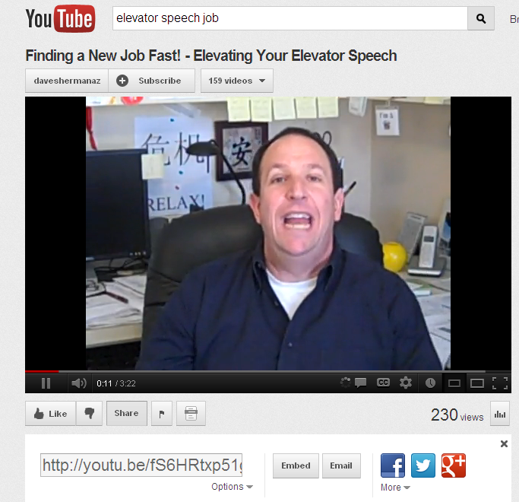
Elevate…
…Your Elevator Speech!
http://www.youtube.com/watch?v=fS6HRtxp51g

Slide 5
The Elevator Speech
A good elevator speech should be:
Brief
Memorable / Interesting
Informative
Respectful of time and place
Ready for use at any time, any place!
An opportunity to ask for a future meeting

Slide 6
Crafting An Elevator Speech
It’s YOURS not mine, so the words and rhythm should reflect how YOU speak
Captures YOU in a forward-looking career sense, not a dry recitation of what you’ve done (state what type of work you want to do)
It should convey what kind of employee you will be (why you make the best employee for the job)

Slide 7
Four Part Introduction
FIRST sentence describes the way you wish to be categorized by the person to help him/her remember you. (Adjective – Adjective – Noun)
SECOND sentence provides some specific achievement(s) that should get the attention of the other person. (How the Adjective suits you)
THIRD sentence provides an aggressive summary of what you can do for the employer. (Description of previous job experience – Noun: former job title)
FOURTH sentence is a call to action, an invitation to follow up.

Slide 8
Putting it Together…
First sentence describes the way you wish to be categorized by that person to help him/her remember you. “Hi, I’m Jane Smith. I’m a customer service professional with more than ten years of experience in the telecommunications and computer fields.”
Second sentence provides some specific achievement(s) that should get the attention of the other person. “I have been recognized by two different employers as an outstanding Customer Service Representative, and my actions have resulted in saving 100s of problem accounts that were threatening to cancel their business relationships.”
Third sentence provides some idea of what I can do for you. “I will be able to do the same thing for you … resolve business issues that threaten to cost you lost revenues …. so you will have happier customers … and more of them.”
Fourth sentence is a call to action, an invitation to follow up. “Here is my business card. Can I call you on Thursday of this week to schedule a short meeting to talk about how I can help [name of the organization] achieve its objectives?”

Slide 9
Putting it Together…
Hi, I’m Jane Smith. I’m a customer service professional with more than ten years of experience in the telecommunications and computer fields.
I have been recognized by two different employers as an outstanding Customer Service Representative, and my actions have resulted in saving hundreds of problem accounts that were threatening to cancel their business relationships.
I will be able to do the same thing for you … resolve business issues that threaten to cost you lost revenues …. so you will have happier customers … and more of them.
Here is my business card. Can I call you on Thursday of this week to schedule a short meeting to talk about how I can help [name of the organization] achieve its objectives?

Slide 10
YOUR Elevator Speech
To Start: Find one or two job ads for a position you would like to apply for and base your elevator speech on this job.
Describe the experience you have that is most relevant to what you want to do going forward. _________________________________________________________________________
_________________________________________________________________________
_________________________________________________________________________
Provide some specific achievement(s) that should get the attention of the other person. ________________________________________________________________________
________________________________________________________________________
________________________________________________________________________
Give some idea of what you can do for them (specifically). ________________________
________________________________________________________________________
________________________________________________________________________
________________________________________________________________________
A call to action, an invitation to follow up. ______________________________________
________________________________________________________________________
________________________________________________________________________
Note: this format is a guide only. Remember, to make it truly YOURS.

Slide 11
Activity…

Slide 12
Obstacles…
The bumps in the road that can hold us back.
We all have them
Don’t ignore them or hope the employer won’t notice
We must understand them from the employer’s point of view
We should try to make them a reason to hire us. (What did you learn from your obstacle?)

Slide 13
Identify Your Obstacles
Legitimate Obstacles
Qualification issues
Lack of relevant experience
Lack of relevant or adequate education
Language issues
Behavioral issues
Criminal background
Substance abuse
Personal issues
Transportation
Childcare (what’s your “plan B”?)
Taking too much sick time
Work history issues
Reliability
Performance
Job-hopping
Policy violations
Illegitimate Obstacles
Race or ethnic background
Gender
Age
Religion
Country of origin
Sexual orientation
Perceived disability / handicap
Veteran Status

Slide 14
Embrace Your Obstacles
Why not avoid / hide it?
Odds are, the employer will find out anyway
Hoping you won’t be asked is poor strategy and generally fails
Why embrace it?
Everybody has obstacles, employers understand that
It shows honesty that you reveal it
It shows confidence that you reveal it
It shows character that you overcome it
How to embrace it?
Don’t refer to it in writing. Leave it out of cover letters, emails, resumes or applications -- unless specifically asked
Practice your introduction of the subject
Do raise it in your interview
Gracefully “beat the interviewer to the subject”
Allows you to present it on your terms
You won’t be as defensive if you bring it up before the interviewer

Slide 15
Embrace Your Obstacle…Sample
OBSTACLE: disagreement with your former supervisor led to termination
What NOT to do: DON’T make excuses or re-argue the facts of the case. DON’T play the victim, or blame it on anyone but yourself.
What TO do:
Accept responsibility
Talk about what you learned from it
Explain WHY you will never make the same mistake again
Describe how you have taken concrete steps to make sure that it will never happen again.

Slide 16
Practice!
My Obstacle: _______________________________________________________________
Impact on my search: _________________________________________________________
How NOT to explain it: _______________________________________________________________________________________________________________________________________________________________________________________________________________________________________________________________________________________________________________________________________________________________________________________
How TO explain it: _______________________________________________________________________________________________________________________________________________________________________________________________________________________________________________________________________________________________________________________________________________________________________________________

Slide 17
Homework!
Elevator Speech/ Obstacles
Create Your Elevator Speech: Tell others who you are in a short introduction.
Assignment: write your elevator speech and be prepared to give it at the beginning of EACH workshop over the next two weeks. Send copies of your first draft to bzewede@maministries.org and mnolte_77565@yahoo.com
Due date: Monday.
Discussion of Your Employment Obstacle(s):
Assignment: identify your greatest obstacle(s) and how you would present it in an interview.
Document it! Say it! Present it!
Send it via email to bzewede@maministries.org and mnolte_77565@yahoo.com
Due date: Monday.

